Slide 1
Gender Classification Through Speech
Authors: Hieu Mai, Tai Nguyen, Harpreet Cheema
Advisor: Dr. Anup Das
Drexel University - Fall 2019

Slide 2
Motivation
Speech recognition is not a solved problem and it’s harder than image recognition of the additional dimension of time
Audio is susceptible to noises and much harder for processing

Slide 3
Preprocessing
Silence removal: original audio -> processed audio
Frequency distribution

Slide 4
CNN
Activations at each stage
Comparisons with other model (CDBN Andrew Ng)
Improvements

Slide 5
SNN

Slide 6
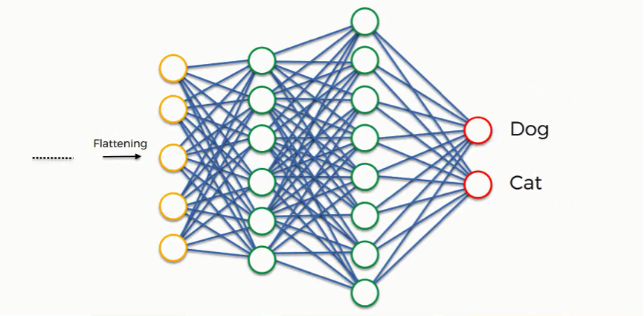
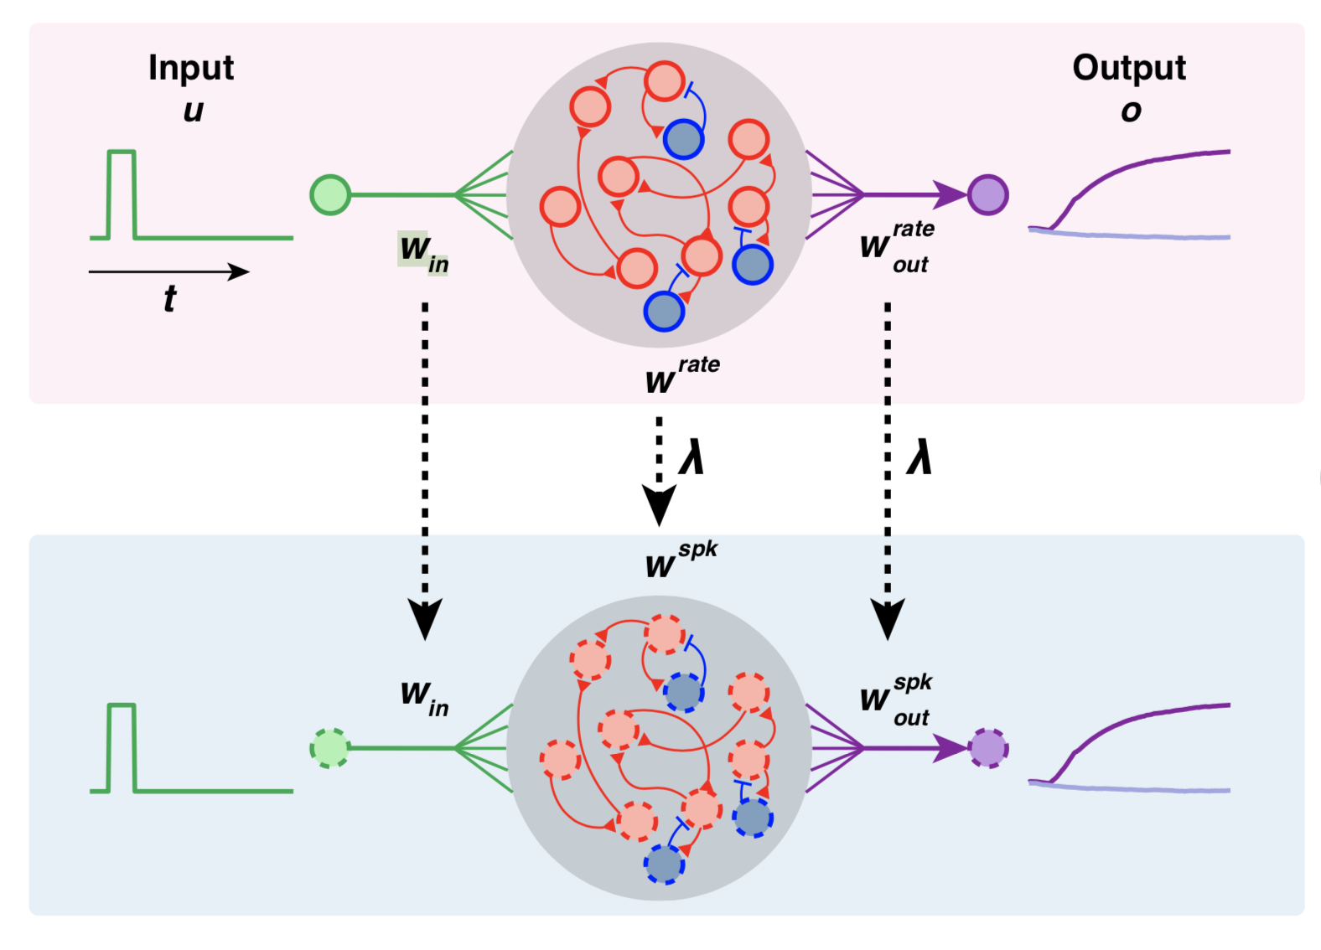
Trade-offs
Accuracy
Accuracy
Power Consumption
Power Consumption

Slide 7
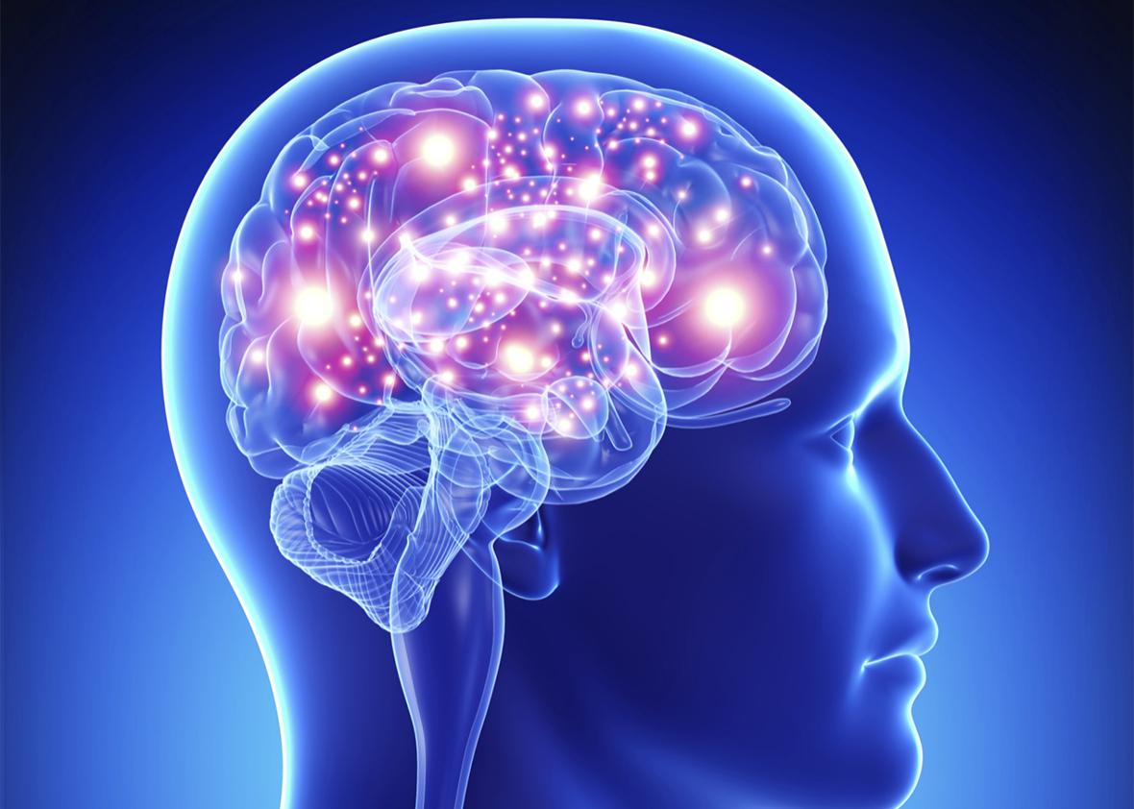
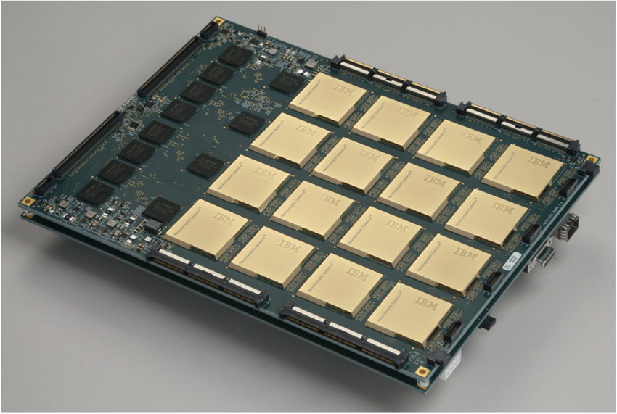
100 billion neurons ~20 W General Intelligence
500 to 1000 times efficiency difference
1 billion neurons ~100 W
Specific Applications
IBM TrueNorth 2019

Slide 8
How it works
Pre-synaptic
Post-synaptic
synapse
synapse

Slide 9
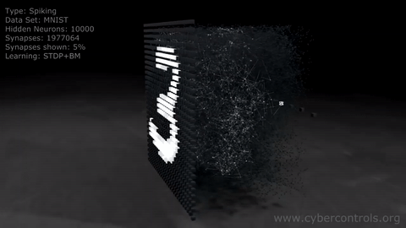
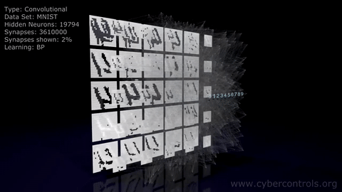
How it works
3D animation created by Denis Dmitriev for cybercontrols.org
Available at: https://www.youtube.com/watch?v=3JQ3hYko51Y

Slide 10
1 x 3 kernel
1 x 3 kernel
99
Max-Pooling Layer
Hidden Layer
13
Input Layer

Slide 11
Results

Slide 12
Future Works
Making SNN more stable (less runaway behavior)
Having Neurons only fire when it absolutely need to
Implementing lossless input signal encoding technique
Better max-pooling SNN technique
Introducing `hint` network
Optimizing on neuromorphic devices

Slide 13
CNN repr: https://www.superdatascience.com/blogs/the-ultimate-guide-to-convolutional-neural-networks-cnn
SNN repr: https://www.zdnet.com/article/neuromorphic-computing-finds-new-life-in-machine-learning/
Power of Human Brain: https://hypertextbook.com/facts/2001/JacquelineLing.shtml
IBM TrueNorth: http://www.research.ibm.com/articles/brain-chip.shtml

Slide 14
LSTM

Slide 15
(maybe conclusion here)

Slide 16
Q&A

